Slide 1

UNIX Workshop: Practical Guide to the Command Line
AAFC Bioinformatics Conference and Workshop
September 19-20, 2019, Lethbridge, Alberta
Miles Buchwaldt
Biology Study Leader – Bioinformatics, Saskatoon RDC
19 Sept. 2019

Slide 2
The Goal of this Workshop
Introduce the fundamental concepts of working in UNIX environments
Beginners will acquire the basics and some exposure to UNIX
Experienced users might learn a trick or two
Independent study and practice will be required to become effective
https://redmine.biodiversity.agr.gc.ca/projects/biocluster/wiki/Biocluster_User_Guide

Slide 3
Table of Contents
1. Basic Commands
2. Input & Output
3. The Environment
4. Non-standard Software
5. Regular Expressions
6. Scripting

Slide 4
Initial Setup
Create a secure shell on the remote server:
$ ssh <username>@<address>
Acquire access to a worker node:
$ qlogin -n 1
Run a script to setup the workshop environment:
$ ./workshop_setup.sh

Slide 6
What is the command line?
User interface, where a user can issues “commands” to the computer carry out various tasks.
Commands follow a strict format:
$ <command> <options> <arguments>
<command>: an executable file on the system
<options>: flags that change the default behavior of the program
<arguments>: information the program requires to carry out it’s task

Slide 7
Locating Files and Directories
Where am I?
$ pwd
What is around me?
$ ls
How do I leave this place?
$ cd

Slide 8
Paths – Relative vs Absolute
Relative path: specifies the path from your current location to the file
Current directory can be referenced with: “./”
One directory up: “../”
Absolute path: specifies the path to the file relative to the base root directory
Begins with “/”

Slide 9
Create, Move, Delete Files
Creating files:
$ touch <filename>
Copying/Moving files:
$ cp <source> <destination>
$ mv <source> <destination>
Deleting files:
$ rm

Slide 10
Reading File Contents
Print a file:
$ cat <filename>
Print the top/bottom of a file:
$ head <filename>
$ tail <filename>
View paginated version:
$ less <filename>

Slide 11
Options
Alter the behavior of commands
Find appropriate options via the manual pages
$ man <command>

Slide 12
Options – Useful Examples
Copy move or delete directories:
$ cp|mv|rm -r <directory>
More detailed directory listing with ls:
-l long listing: shows more information
-a all files: includes hidden files
-h human readable file sizes

Slide 13

Input and Output
Text Streams
Redirection
Pipes

Slide 14
Text Streams
Text streams are blocks of characters, usually separated by newlines that a program uses to communicate with it’s environment
STDIN (file descriptor: 0)
STDOUT (file descriptor: 1)
STDERR (file descriptor: 2)
Most commands take input from STDIN, output to STDOUT and if there are errors, send error information to STDERR
Notes:
Fundamentally, everything in UNIX operates on text

Slide 15
Redirection
These three text streams can be redirected to each other, or to files
Redirect STDIN (read from file)
$ cat < text.txt
Redirect STDOUT
$ cat text.txt > copyOfText.txt
$ cat text.txt >> textTwice.txt (append)
Redirect STDERR
$ cat text.txt 2> errorsText.txt
$ cat text.txt 2>&1 outputAndErrors.txt

Slide 16
Pipes
Another form of redirection:
STDOUT of one command is sent to STDIN of another command
Used to “chain” commands together
$ grep “^$” data.txt | wc -l
$ history | grep “java”
$ tar -tzv Tarball.tar.gz | less
Notes:
Pipes are what give UNIX systems it’s power. The possibilities are only limited by the user’s creativity and knowledge of available commands.

Slide 17

The Environment
Do you think those are buttons you are clicking? Do you honestly think that your mouse has any effect on your commands, in here?
Variables
Permissions
Important Directories

Slide 18
Where do commands go?
The “interpreter”, sh, bash, perl, python
Variables:
$PATH, $HOME, $USER
Print a variable’s contents with:
$ echo <$VARIABLE>
Set a variable with:
$ export VARIABLENAME=“New value”
*$ export PATH=$PATH:/path/to/new/software*

Slide 19
Variables
Some software has prerequisite packages, libraries, modules.
These are found using variables containing the path to the required files:
$LD_LIBRARY_PATH
$PERL5LIB
$LIBPATH
To get a list of the current variables:
$ printenv

Slide 20
Environment Setup
When you connected to the BioCluster with “ssh” the commands in ~/.bashrc, ~/.bash_profile are executed
Edit these files with a text editor
Must restart shell session, or source the files before changes come into effect:
$ source ~/.bash_profile
$ . ~/.bashrc

Slide 21

Software
READ THE DOCUMENTATION! You can usually find it in INSTALL.txt, README.*, the GitHub page, the wiki, or with a google search.
Installation
Execution
Troubleshooting

Slide 22
Installing New Programs (via git)
Download a git repository
$ git clone https://github.com/lh3/bwa.git
Look out for special instructions that pertain to you
Likely a local installation!
$ ./configure --prefix=~/bin

Slide 23
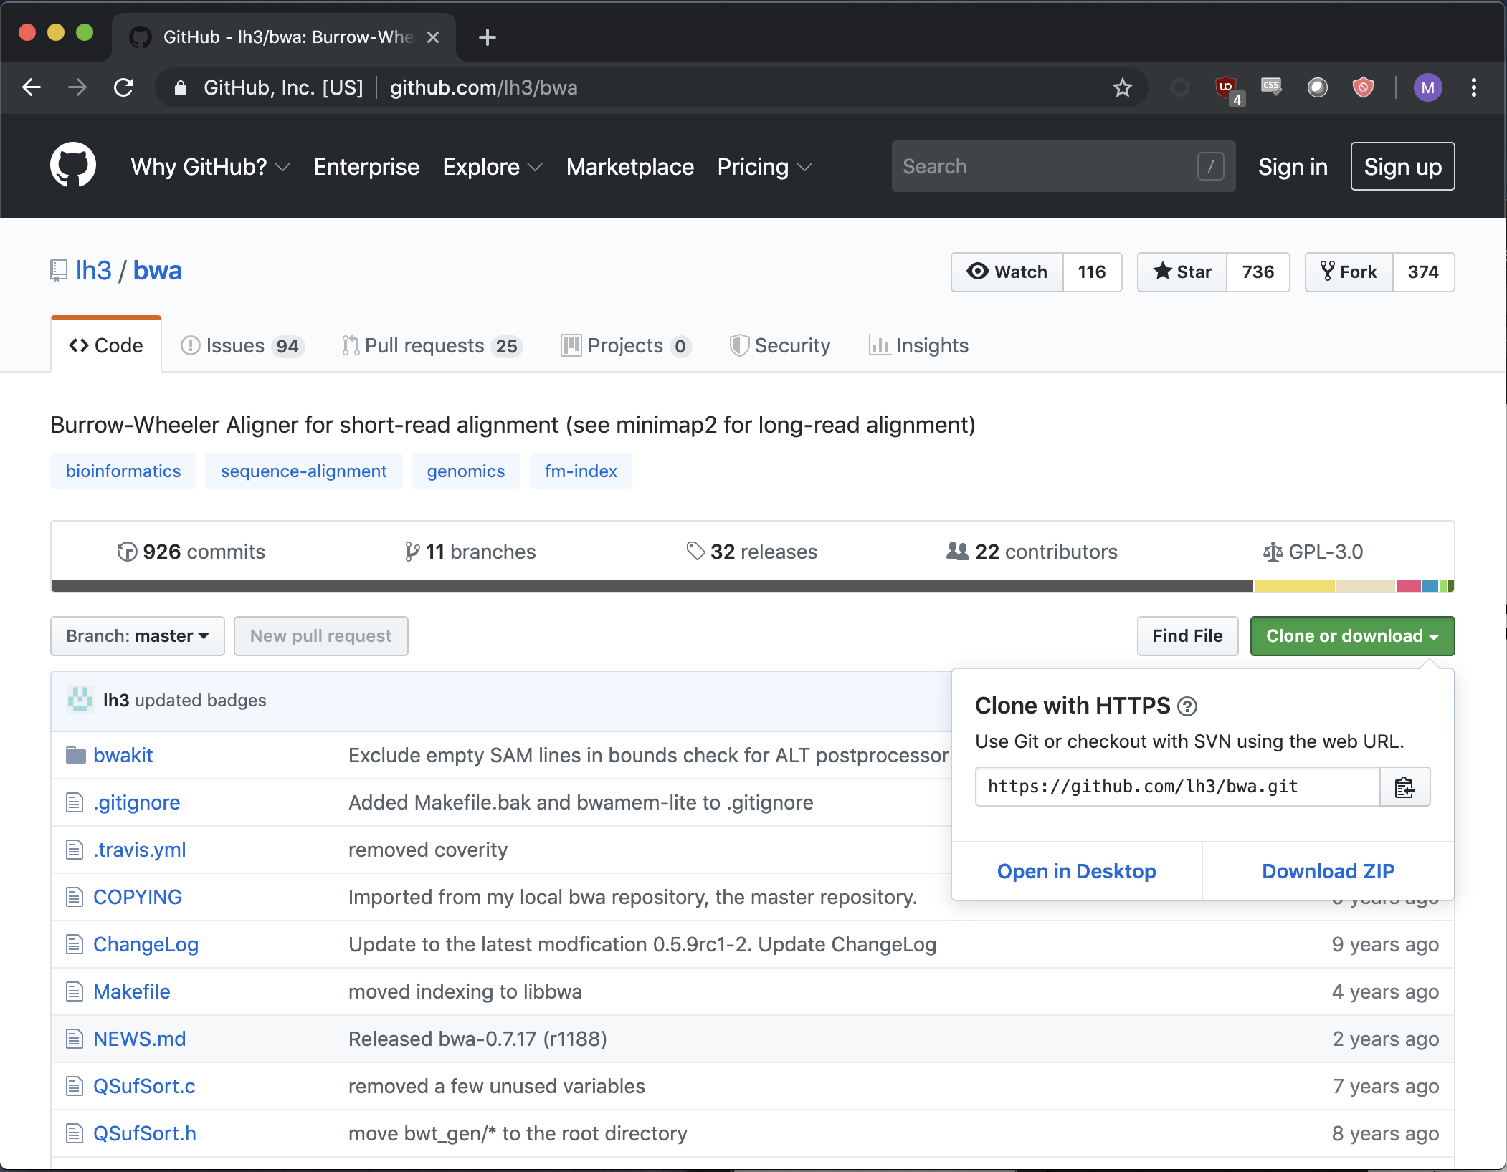
To get github link:
CLICK THIS

Slide 24
Make and Makefiles
./configure [--prefix=~/bin]
make
make install
Look out for errors in the above and Read Them
Most likely causes for compilation errors are missing or incorrect version of dependencies.

Slide 25
Add To Path
To use a new command without specifying the relative/absolute path to it each time:
$ export PATH=$PATH:/path/to/command
Or add to ~/.bash_profile or ~/.bashrc
$ source ~/.bash_profile
$ which command

Slide 26

Dependencies
Instructions for software requirements usually come before installation instructions.
Some dependencies will require administrative priviledges (superuser)
Libraries, compiler versions
These can often be overcome with virtual environments
Some dependencies can be installed by the user as long as the required version is specified in environment variables.

Slide 27
Running Software
Read Documentation: README.txt, README.md, etc.
$ <command> <options> <arguments>
$ java -jar /path/to/software.jar <options> <arguments>
$ perl script.pl <options> <arguments>
$
Make sure you understand what the command will do before you press enter!

Slide 28
Monitoring Jobs
top, PID, ps, kill,

Slide 29
Regular Expressions (shell)
Wildcards
Loops

Slide 30
Wildcards
Wildcards are special characters that have special meaning to the interpreter

Slide 32
Shell Scripts
Variables
Conditionals
Loops

Slide 33
Scripts
Are “interpreted” sets of instructions to control other programs
Differ from “compiled” software
Good for automating small, repetitive tasks.
Notes:
Interpreted -> not compiled

Slide 34
Shebang line
Specifies the interpreter that will parse your script
Can use absolute path:
#!/bin/bash
Better to use env as other systems may not have the same bash location
#!/usr/bin/env bash

Slide 35
Arguments
Allows the user to give contextual information to the program
Can be done simply:
VARIABLEONE=“$1”
VARIABLETWO=“$2”
This approach makes assumptions about the order and format of arguments

Slide 36
Variables
Store data

Slide 37
Conditionals
Run a code segment only if a condition is satisfied
Useful for specific tasks, and also to avoid error states

Slide 38
Loops
Run a code segment multiple times
Common pitfalls:
Infinite loops
Off-by-one errors
Different types:
For loops
While loops
Recursion (too complicated for this workshop and rarely required)

Slide 39
Functions

Slide 40
Scripting Best Practices

Slide 41
Best Practices
Formatting:
Variables, functions and commands should be distinct
CAPITAL_AND_UNDERSCORES
camelCaseFormat or CamelCaseFormat
lowercase_and_underscores
However you choose to distinguish these is fine, just be consistent.

Slide 42
Arguments
Can eliminate assumptions made for argument format and order using case

Slide 43
VARIABLEONE=“/path/to/file1.txt”
VARIABLETWO=“/path/to/file2.txt”
while [ $# -gt 0 ]; do
case “$1” in
-v1|--variable1)
VARIABLEONE=“$2”
shift 2
;;
-v2|--variable2)
VARIABLEONE=“$2”
shift 2
;;
*)
break
;;
esac
done
# Some simple argument checks
wrong_arg() {
echo "Error: invalid value for $1" >&2
exit 2
}
[ -f $IN_FILE ] || wrong_arg "input file"
[ -f $OUT_FILE ] || wrong_arg "output file"

Slide 44
Debugging
Using the ”set” builtin, can activate debugging mode:
set -x
Prints all command executions and variable changes
set -euo pipefail
Exit when commands fail, var references are not declared and when pipes fail

